Slide 1
Non-Technical Quiz

Slide 2
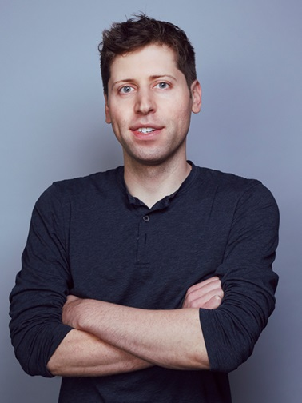
Who is This???
A)Steve Jobs
B) Greg Peters
C)Sam Altman
D)Carl Pei

Slide 3
Answers
C)Sam Altman - CEO of OpenAI

Slide 4
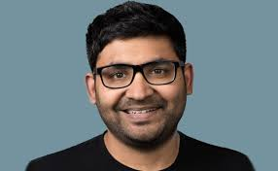
Who is This??
A)Parag Agrawal
B)Neal Mohan
C)Sundar Pichai
D)Satya Nadella

Slide 5
Answer
A)Parag Agrawal – Former CEO of Twitter (now Known as ‘X’)

Slide 6
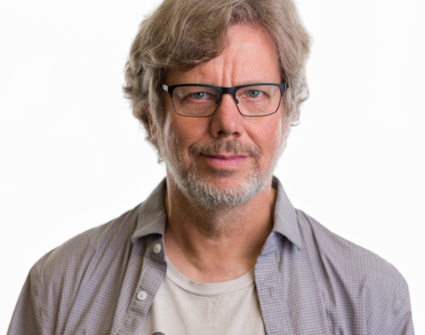
Who is This??
A)Guido Van Rossum
B)Larry Page
C)Steve Wozniak
D)James Gosling

Slide 7
Answer
A)Guido Van Rossum – Founder of Python

Slide 8

Guess The Logo??
A)Python
B)MySQL
C)JavaScript
D)HTML

Slide 9
Answer
B)MySQL

Slide 10
Which Is Not A Programming Language??
A)JavaScript
B)CoffeeScript
C)Rajini++
D)NodeJS

Slide 11
Answer
D)NodeJS
Explanation:NodeJs is not a programming language; its an open source javascript Runtime Environment that executes Javascript code outside a web browser

Slide 12
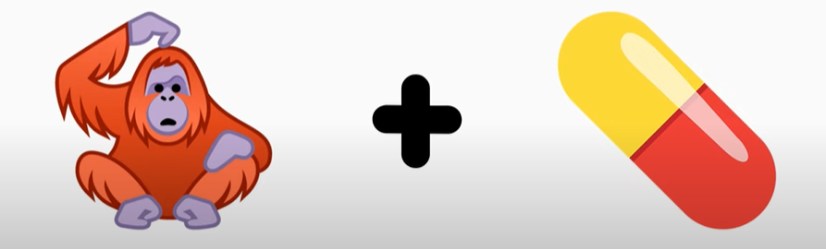
Guess The Brand??

Slide 13
Answer
Apple – Ape + Pill

Slide 14

Guess…

Slide 15
Answer
WWW - World Wide Web

Slide 16
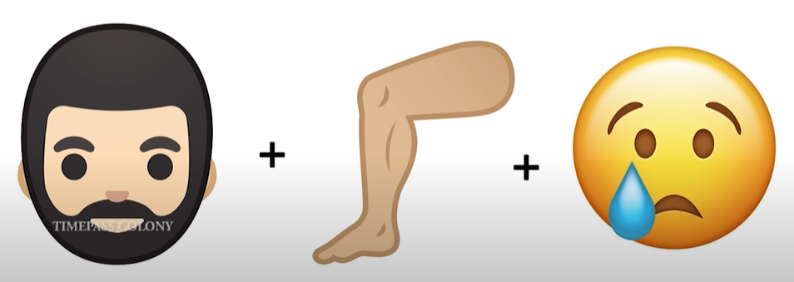
Guess…

Slide 17
Answer
Monitor

Slide 18
Which of the Following Statement is incorrect??
A) d={“city”:”Chennai”}
B) d={(‘a’,’b’):”Example”}
C) d={[‘a’,’b’]:”Example”}
D) d={1:”Hello”,2:”City”}

Slide 19
Answer
C) d={[‘a’,’b’]:”Example”}

